Slide 1
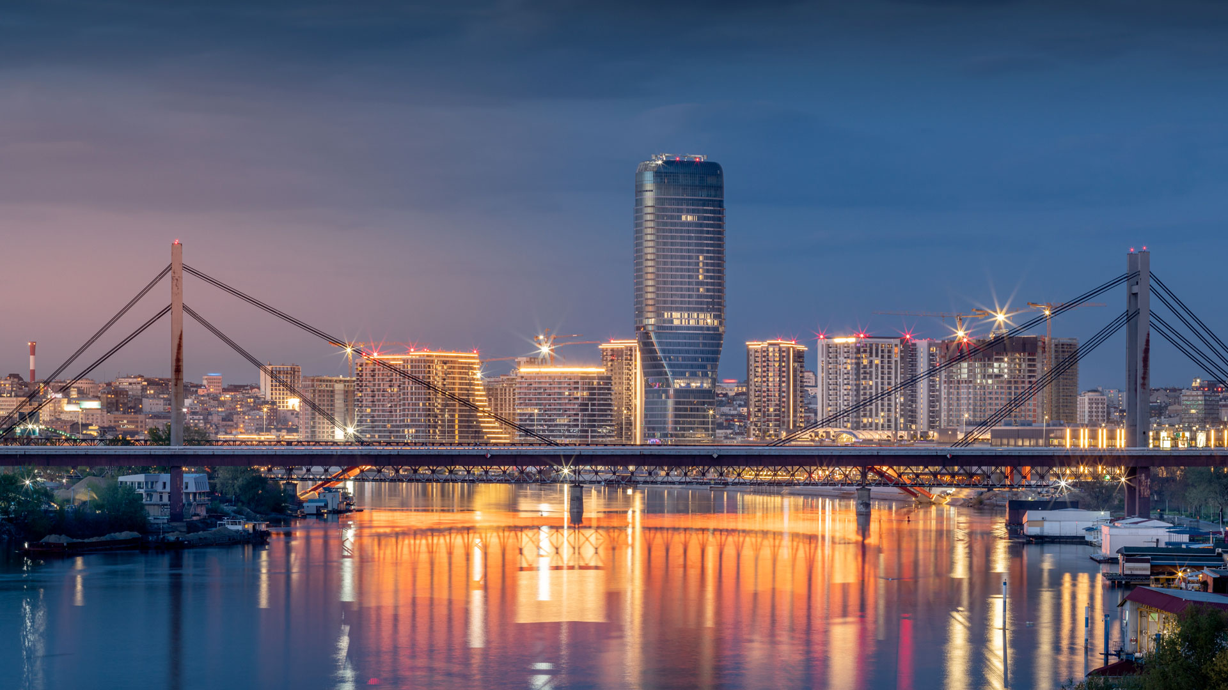
The Government of the Republic of Serbia
Serbia’s AI Ecosystem
Presenting the opportunities with Artificial Intelligence in Serbia in 2024.
2024
Belgrade, Serbia
COPYRIGHT © 2023 THE GOVERNMENT OF THE REPUBLIC OF SERBIA. ALL RIGHTS RESERVED.

Slide 2
The Government of the Republic of Serbia
SERBIA HAS BEEN ATTRACTING AI INVESTMENTS
Latest Tech Related stats:
No.1
Country in Europe in growth of services
For the period 2016 - 2022
No.3
Country in Europe in growth of ICT Export
For the period 2016 – 2022
x5
ICT Export growth in 6 years, from €740 million to €3.5 billion in 2023
By far the largest net exporting industry of Serbia
>112k
People employed in the ICT sector
One of the highest growths of ICT employment in Europe
COPYRIGHT © 2023 THE GOVERNMENT OF THE REPUBLIC OF SERBIA. ALL RIGHTS RESERVED.

Slide 3
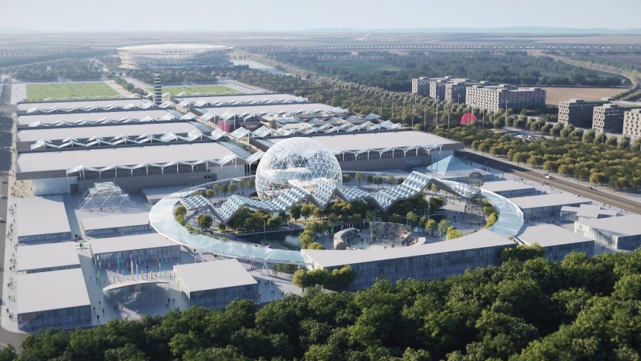
The Government of the Republic of Serbia
Brief Overview of the AI Road Map in Serbia
Serbia’s AI Platform in
Top 10 Best Public Sector Innovation Projects by OECD
The Government establishes
the Institute for AI
a Center of
Excellence, 1st such Institute Southeast Europe
Expected >500 students enrolled into AI master programs.
focused on digitalization
of all private
industries
2023
2025
Introduced 7 new master programs in AI at 6 faculties,
4 Universities
Adopted ethical guidelines for AI
Introduced tax incentives for R&D
2021
2022
2020
Elementary schools
Serbia becomes member of AI Governance Alliance
1st to adopt the National AI Strategy
in Southeast Europe
7th & 8th grade AI subjects
High Schools
Opened 3 new Science Technology Parks – Niš, Čačak,
Novi Sad
have an
AI elective subject
2018
2019
Coding as mandatory subject in elementary schools
Serbia becomes part GPAI
The Centre of Digital Transformation
a coordination & implementation body
2017
COPYRIGHT © 2023 THE GOVERNMENT OF THE REPUBLIC OF SERBIA. ALL RIGHTS RESERVED.

Slide 4
The Government of the Republic of Serbia
Serbia in AI | 2024 development news
Activities 2024
Serbia is creating the new
Serbia is planning to invest
Serbia will develop
2030
€80 million
AI Regulations
National AI Strategy
into implementing AI Solutions in the public sector.
more competetive than those in EU
COPYRIGHT © 2023 THE GOVERNMENT OF THE REPUBLIC OF SERBIA. ALL RIGHTS RESERVED.

Slide 5
The Government of the Republic of Serbia
Serbia joined GPAI in 2022
Serbia becomes part of the Global Partnership on Artificial Intelligence, GPAI
2022
1
2
3
4
Built around a shared commitment to the OECD Recommendation on Artificial Intelligence AI-related priorities
Serbia is one of the 29 country members of GPAI
Aims to bridge the gap between theory & practice on AI
Supports cutting-edge research and applied AI activities
COPYRIGHT © 2023 THE GOVERNMENT OF THE REPUBLIC OF SERBIA. ALL RIGHTS RESERVED.

Slide 6
The Government of the Republic of Serbia
The Government of the Republic of Serbia
BREAKING NEWS| Beginning of 2024
Serbia will chair the Global Partnership on Artificial Intelligence (GPAI) in the next three years!
2024
2025
2026
Co-chair
Chair
Co-chair
Serbia, 29th country Member of GPAI
8 March 2024
COPYRIGHT © 2023 THE GOVERNMENT OF THE REPUBLIC OF SERBIA. ALL RIGHTS RESERVED.
News Source: Link

Slide 7
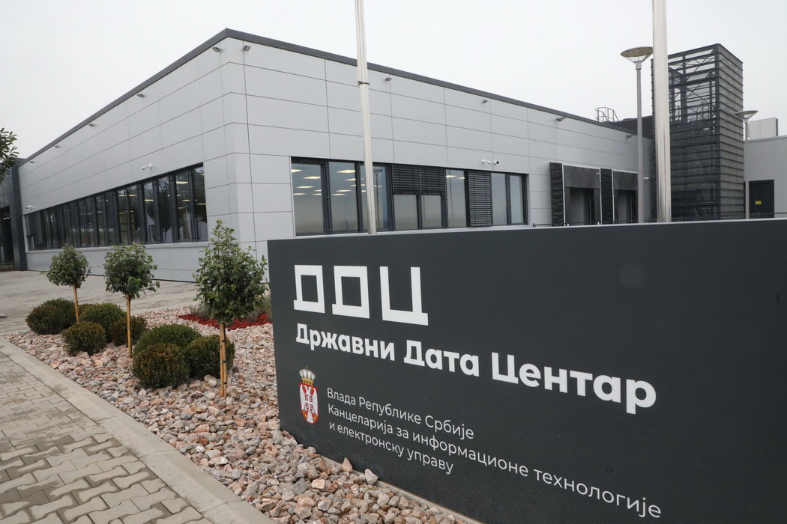
Serbia’s National AI
supercomputing platform
The Government of the Republic of Serbia
Secured investment of €30 million EUR
for a new Supercomputer
State Data Center, Kragujevac
Selected in TOP 10 BEST public sector innovation projects by OECD
Observatory of Public Service Innovation in 2023.
Free of charge for universities, institutes, & start-up companies to develop AI solutions
+70 users with more than 300 user accounts with rapidly growing number of tests
COPYRIGHT © 2023 THE GOVERNMENT OF THE REPUBLIC OF SERBIA. ALL RIGHTS RESERVED.

Slide 8
The Government of the Republic of Serbia
Serbia’s primary goals 2024 - 2027
End of 2023
2024
2026
2027
1. Allocation of funds for expansion Data Centre Kragujevac
2. Construction under way for 3 new STP in Niš, Kruševac, Čačak
3. Ending of BIO⁴ Campus development
4. Issued testing licenses for Autonomous vehicles Level 5
5. Continuous R&D and Investment in Artificial Intelligence

Slide 9
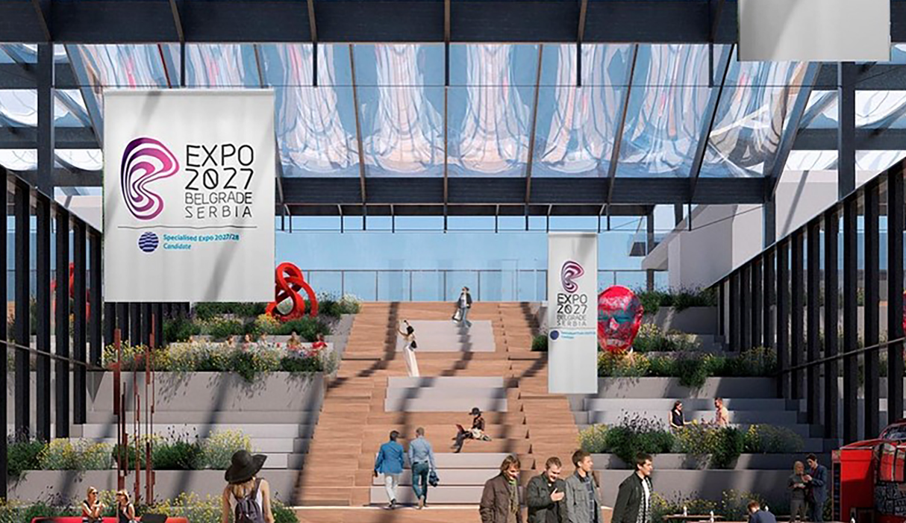
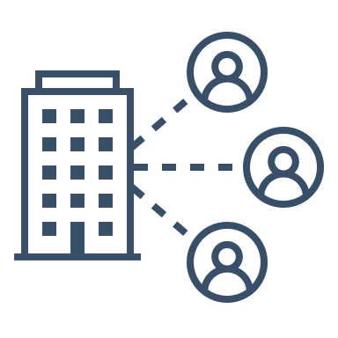
The Government of the Republic of Serbia
Serbia’s most valuable projects
Serbia invests
BIO4 Campus
EXPO 2027
Construction under way for new STP’s.
Signed loan agreement and a project agreement between the government of the Republic of Serbia and the EBRD secured €80 million
BIO4 stands for 4 key areas: biomedicine, biotechnology, bioinformatics, and biodiversity
"EXPO 2027 BELGRADE" theme - "Play for Humanity" in Belgrade from May 15th to August 15th, 2027.
7 Faculties 9 Scientific Institutes 1400 Professors and Researchers 4000 Students +1000 Ph.D +300 Laboratories 7 Centers of Excel lence
The Fair & Expo complex total area of 25ha, a total exhibition space of 230,000m2 gross, & participation from over 100 countries, 2.5 million visitors
€70 million is being allocated for the construction of science parks in Cacak, Nis and Krusevac
First bioeconomic hub in SEE
Autonomous bus transport for EXPO visitors
Development and use of AI on a large scale and foster the development of human capacities, science, and applications.

Slide 10
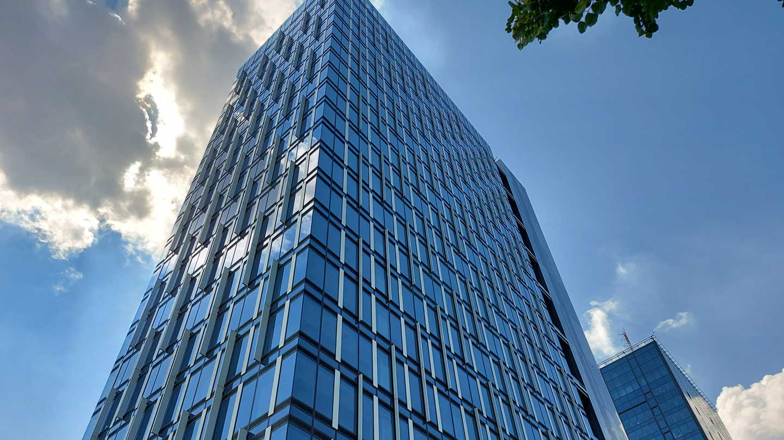
The Government of the Republic of Serbia
Brief overview:
Foreign Direct Investments
in Serbia
Internationally Recognized
COPYRIGHT © 2023 THE GOVERNMENT OF THE REPUBLIC OF SERBIA. ALL RIGHTS RESERVED.

Slide 11
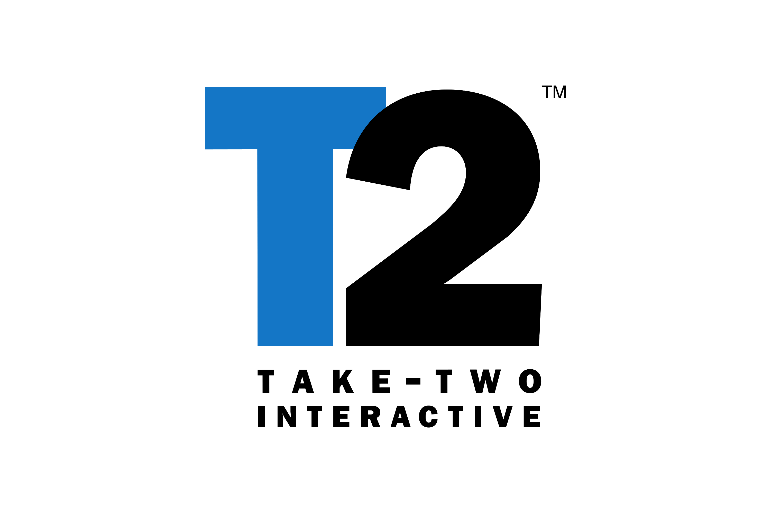
The Government of the Republic of Serbia
Serbia has had record breaking FDI success
FDI increased 4X from 2012
In 2022, Serbia attracted
4.3 billion EUR
in FDI
Notable Foreign Direct Investment
FDI Performance compared to Western Balkans
Other Western Balkan Countries
37%
63%
Serbia
COPYRIGHT © 2023 THE GOVERNMENT OF THE REPUBLIC OF SERBIA. ALL RIGHTS RESERVED.

Slide 12
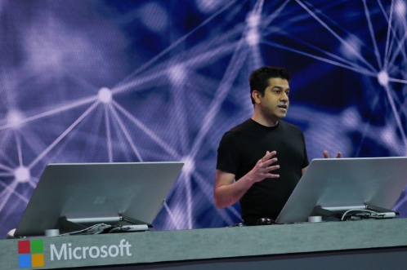
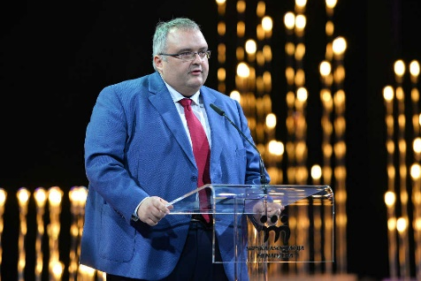
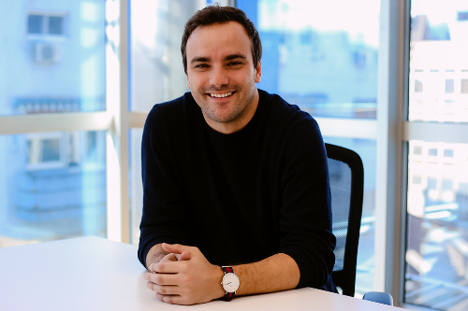
The Government of the Republic of Serbia
Notable testimonials about Serbia’s R&D Sector
“
The team in Serbia demonstrated amazing talent.
“
“
The attitude the team
has shown has been an amazing thing to watch.
We recognized
knowledge, innovation and experience of young engineers in the Republic of Serbia and invested resources in the DMS from Novi Sad, which is now a global center of Schneider Electric research.
Mr. Rohan Kumar, Corporate Vice President, Azure Data, Microsoft
Mr. Dragoljub Damjanovic, General Manager, Schneider Electric Serbia
“
Serbia was the perfect location for us since this region has an incredible group of young and talented people among both the VFX artist and the AI engineering community.
Mr. Nikola Todorovic, Wonder Dynamics

Slide 13
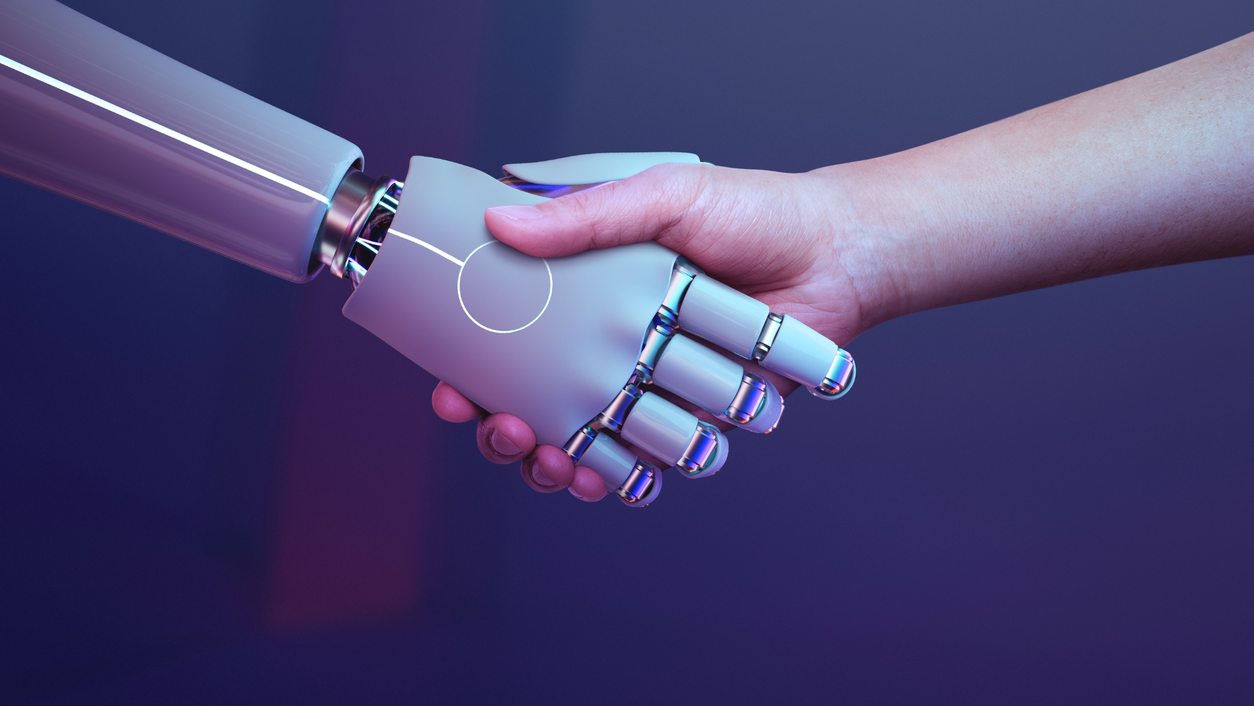
The Government of the Republic of Serbia
Brief overview:
AI ecosystem
in Serbia
COPYRIGHT © 2023 THE GOVERNMENT OF THE REPUBLIC OF SERBIA. ALL RIGHTS RESERVED.

Slide 14
The Government of the Republic of Serbia
1st
The Government of the Republic of Serbia
2nd
Corporate sector
The Government of the Republic of Serbia
3rd
Start-up sector
Public sector

Slide 15
The Government of the Republic of Serbia
1st
The Government of the Republic of Serbia
2nd
Corporate sector
The Government of the Republic of Serbia
3rd
Start-up sector
Public sector

Slide 16
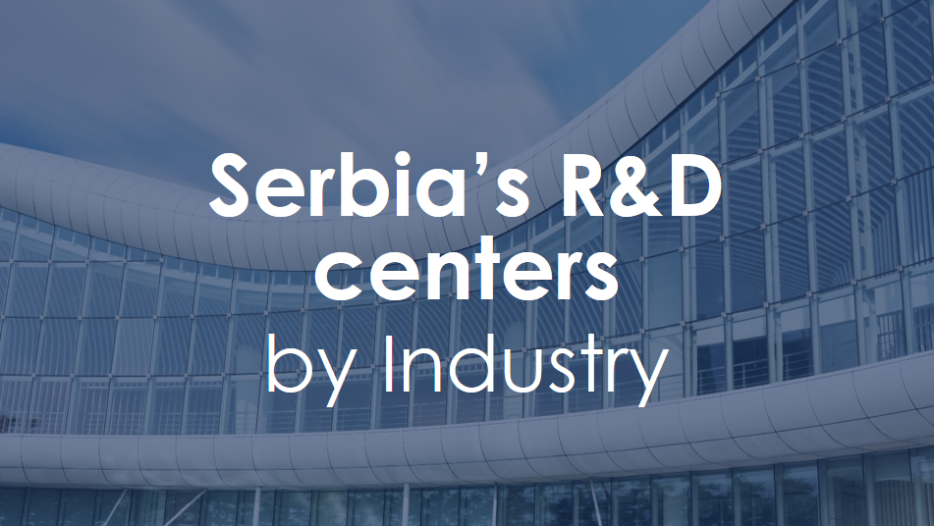
The Government of the Republic of Serbia
Established state of the art R&D infrastructure for the future
Latest in 2022
Providing key services and potential development of new products of the World of Tanks and World of Warships franchises
2020
Developing 4th gen AI-driven computer vision solutions
Acquired 3Lateral - Developing technologies for digitalization of humans
Schneider Electric NS DMS -Producing software enabling big savings in power distribution
2010
Acquired Nordeus - The games company behind Top Eleven, Heroic & Golden Boot
Opened a software development centre to provide better services and support to users in the wider region
2005
ContiTech Fluid - production of hose and piping lines
R&D Center Novi Sad contributing to as digitalization, autonomous and safe driving, & electro mobility
Creating cutting-edge technology for Microsoft 365
COPYRIGHT © 2023 THE GOVERNMENT OF THE REPUBLIC OF SERBIA. ALL RIGHTS RESERVED.

Slide 17
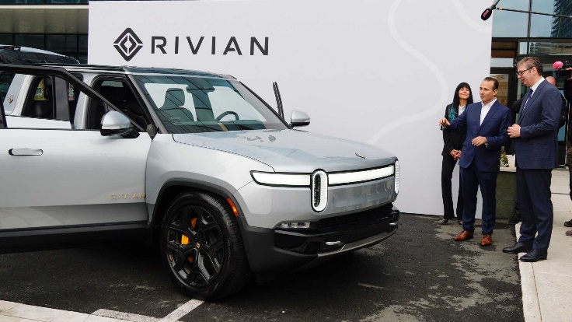
The Government of the Republic of Serbia
Established state of the art R&D infrastructure for the future
Arrived in 2003
Arrived in 2022
Latest in 2022
Celebrating 20 years on the market
800
employees
Providing key services and potential development of new products of the World of Tanks and World of Warships franchises
Employing 200 engineers
Development the vehicle software, ADAS & enterprise technologies
Government of Serbia is using Microsoft technologies, leading to modernization of applications & infrastructure with increased security.
2020
Developing 4th gen AI-driven computer vision solutions
Launched the Global Skills Initiative & 60,000 people in Serbia have benefited from this type of digital skills education.
Acquired 3Lateral - Developing technologies for digitalization of humans
Acquired Nordeus - The games company behind Top Eleven, Heroic & Golden Boot
Schneider Electric NS DMS -Producing software enabling big savings in power distribution
2010
Azure Team, working on Azure AI platform, in Belgrade, develops the most significant data processing services - the Microsoft Cloud.
Opened a software development centre to provide better services and support to users in the wider region
2005
ContiTech Fluid - production of hose and piping lines
Partnered with NGO Petlja in 2017, to promote coding education for children, helping young people in Serbia develop new skills
American electric vehicle producer Rivian opens technology center in Serbia’s capital Belgrade
R&D Center Novi Sad contributing to as digitalization, autonomous and safe driving, & electro mobility
Creating cutting-edge technology for Microsoft 365
COPYRIGHT © 2023 THE GOVERNMENT OF THE REPUBLIC OF SERBIA. ALL RIGHTS RESERVED.

Slide 18
The Government of the Republic of Serbia
1st
The Government of the Republic of Serbia
2nd
Corporate sector
The Government of the Republic of Serbia
3rd
Start-up sector
Public sector

Slide 19
The Government of the Republic of Serbia
Award-winning
“Belgrade - Novi Sad
Ecosystem is in
Top 10
“European Ecosystems
in Affordable Talent”
by Startup Genome.”
Novi Sad
Belgrade
COPYRIGHT © 2023 THE GOVERNMENT OF THE REPUBLIC OF SERBIA. ALL RIGHTS RESERVED.

Slide 20
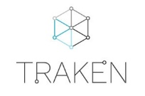
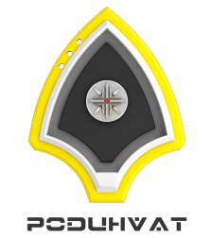
The Government of the Republic of Serbia
Over 150 Start-ups in Serbia use AI as core tech
IT Ecosystem in Serbia
Recycling
Energy
8 universities
4 Science Technology Parks
Data tracking, management and exploitation tool for smart electrical grids
Ensuring faster workflow & automation through the new gen solutions in the energy & construction industry
Digitizes energy providers with data science models to distinguish different load patterns
All-natural insulation liner for the transportation of food products
Creating digital solutions for beverage packs recycling
Creating biodegradable materials from mushrooms
15
startup centers
5 IT clusters
Computer Vision, Sensors
20+ co-working hubs
Helps partners develop meaningful data solutions and functional data strategies for challenging business problems
Leader in the ultra-high-fidelity controller-Hardware-in-the-Loop (C-HIL) simulation for power electronics, micro grids, & distribution networks.
High tech B2B partner in the innovation & new electronics products development
Deep technology company focusing on computer vision (AI) & big data
There are 600 Start-ups in Serbia
Development of global transformation solutions: (modular) wind turbines, wind-sun hybrid renewable energy devices, etc.
>25%
use AI as their core technology
>200
use data science
Focused on advanced robotics projects, with collaborative & traditional industrial robots
Transforming ADAS validation & AV training through software platform automating & streamlining the validation & training process
Creating tech solutions through innovative algorithms and software
Helps oil companies and new energy transition companies to prevent the risk and accidents with Machine Learning
COPYRIGHT © 2023 THE GOVERNMENT OF THE REPUBLIC OF SERBIA. ALL RIGHTS RESERVED.

Slide 21
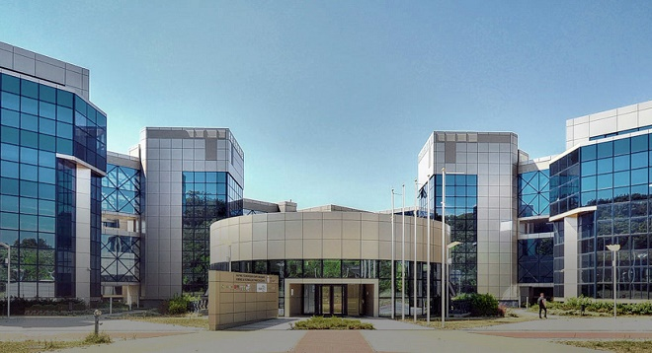
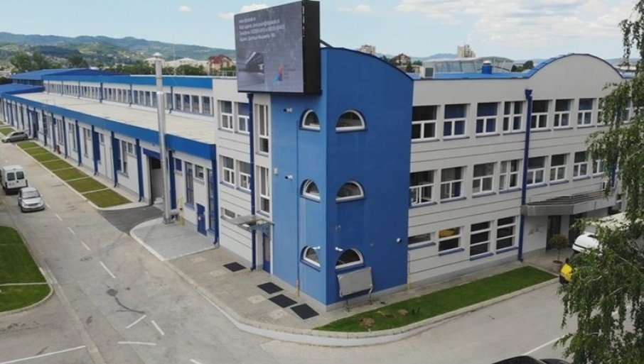
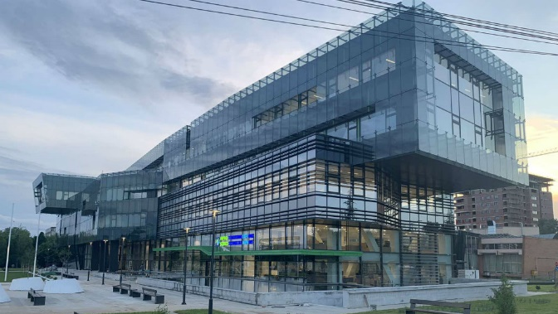
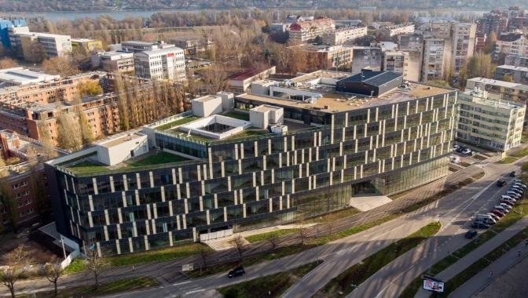
The Government of the Republic of Serbia
Start-up sector supported through Science Technology Parks
Belgrade
Čačak
Opened
in 2015
Opened
in 2020
16.4 K m²
3.6 K m²
Niš
Novi Sad
Opened
in 2020
Opened
in 2020
4.2 K m²
30 K m²
COPYRIGHT © 2023 THE GOVERNMENT OF THE REPUBLIC OF SERBIA. ALL RIGHTS RESERVED.

Slide 22
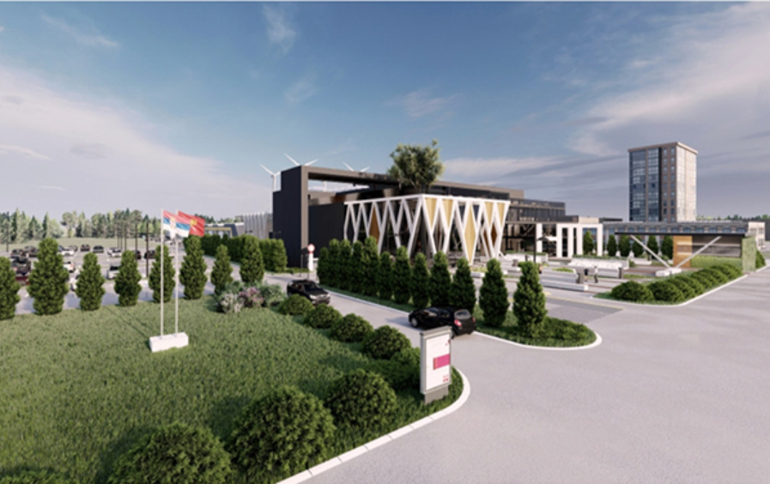
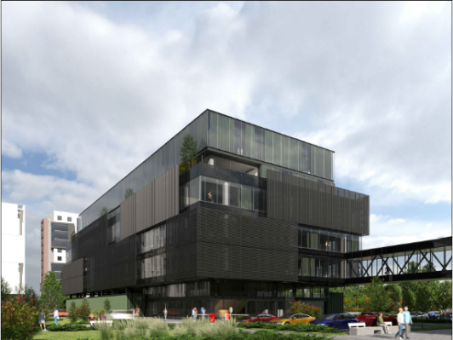
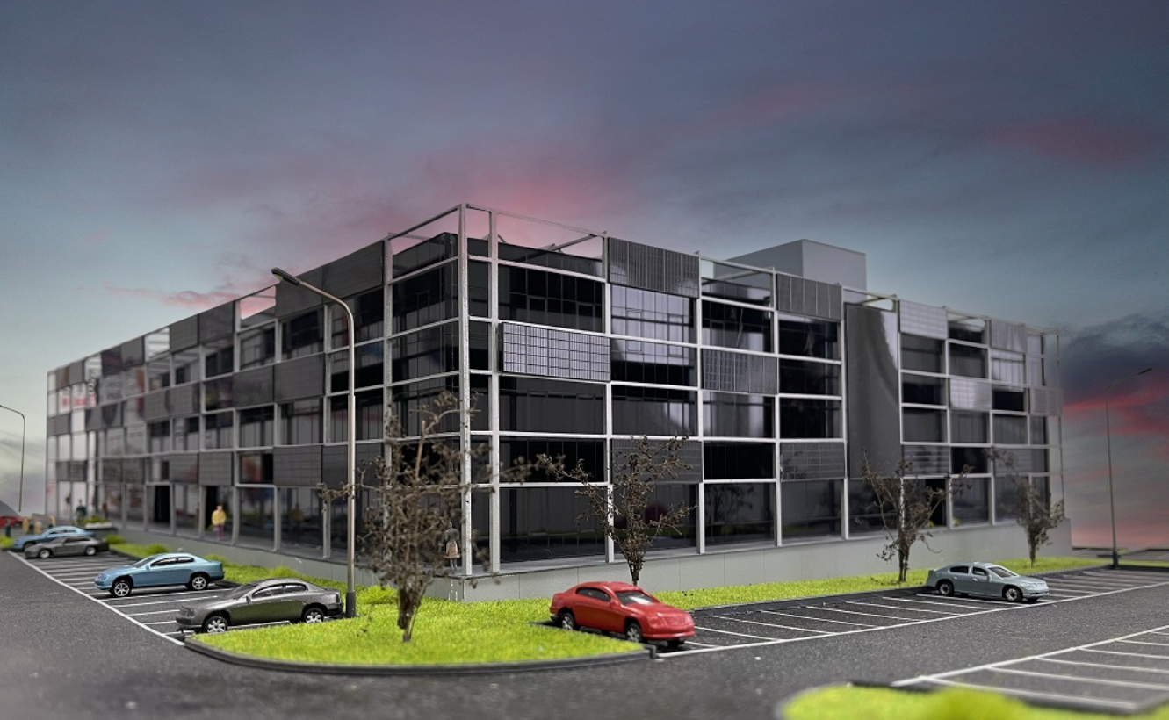
The Government of the Republic of Serbia
The Government of the Republic of Serbia
Construction of STP’s
The Government of the Republic of Serbia
Start-up sector supported through Science Technology Parks
Belgrade
Čačak
New Science & Technology Park - Kruševac
Phase 2 of STP
Niš
Phase 2 of STP Čačak
Opened
in 2015
Opened
in 2020
16.4 K m²
3.6 K m²
Niš
Novi Sad
11.000 m²
16.200 m²
12.800 m²
Opened
in 2020
Opened
in 2020
Construction is under way for additional science and technology parks with a €70 million investment.
30 K m²
4.2 K m²
COPYRIGHT © 2023 THE GOVERNMENT OF THE REPUBLIC OF SERBIA. ALL RIGHTS RESERVED.
COPYRIGHT © 2023 THE GOVERNMENT OF THE REPUBLIC OF SERBIA. ALL RIGHTS RESERVED.

Slide 23
The Government of the Republic of Serbia
1st
The Government of the Republic of Serbia
2nd
Corporate sector
The Government of the Republic of Serbia
3rd
Start-up sector
Public sector

Slide 24
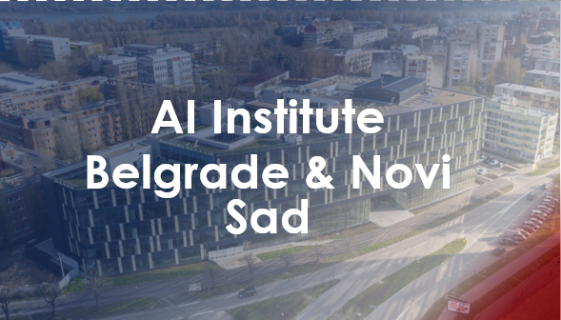
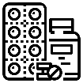
The Government of the Republic of Serbia
Serbia growing public sector initiatives in AI
Researched topics
Deep Computer Vision & Remote Sensing
Pharma and Healthcare sector
Natural Language processing
Real – time data-driven decision making
Well-being of citizens, Smart Cities, Ecology
Successful implementations
Founded
in 2021
53 researchers
3
4
International
research projects
Patent applications
Accredited in 2022
With 33 PhD’s
National research projects
Projects with
corporate entities
2
13
In 2 big
cities
20
associates
2
7
Projects with
public institutions
Horizon projects
COPYRIGHT © 2023 THE GOVERNMENT OF THE REPUBLIC OF SERBIA. ALL RIGHTS RESERVED.

Slide 25
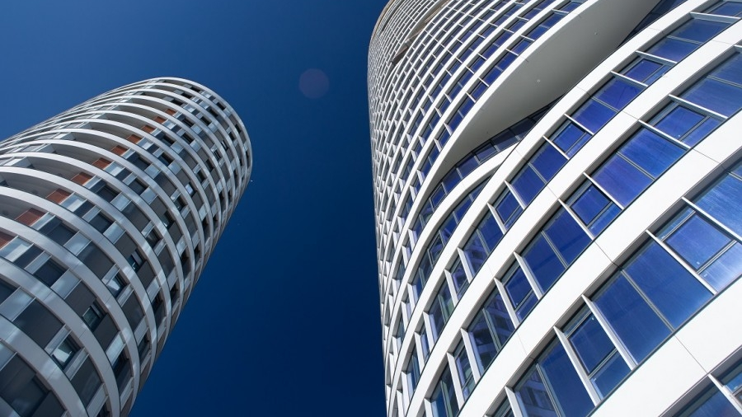
`
The Government of the Republic of Serbia
Brief overview:
Business environment in Serbia
Cost-efficient
COPYRIGHT © 2023 THE GOVERNMENT OF THE REPUBLIC OF SERBIA. ALL RIGHTS RESERVED.

Slide 26
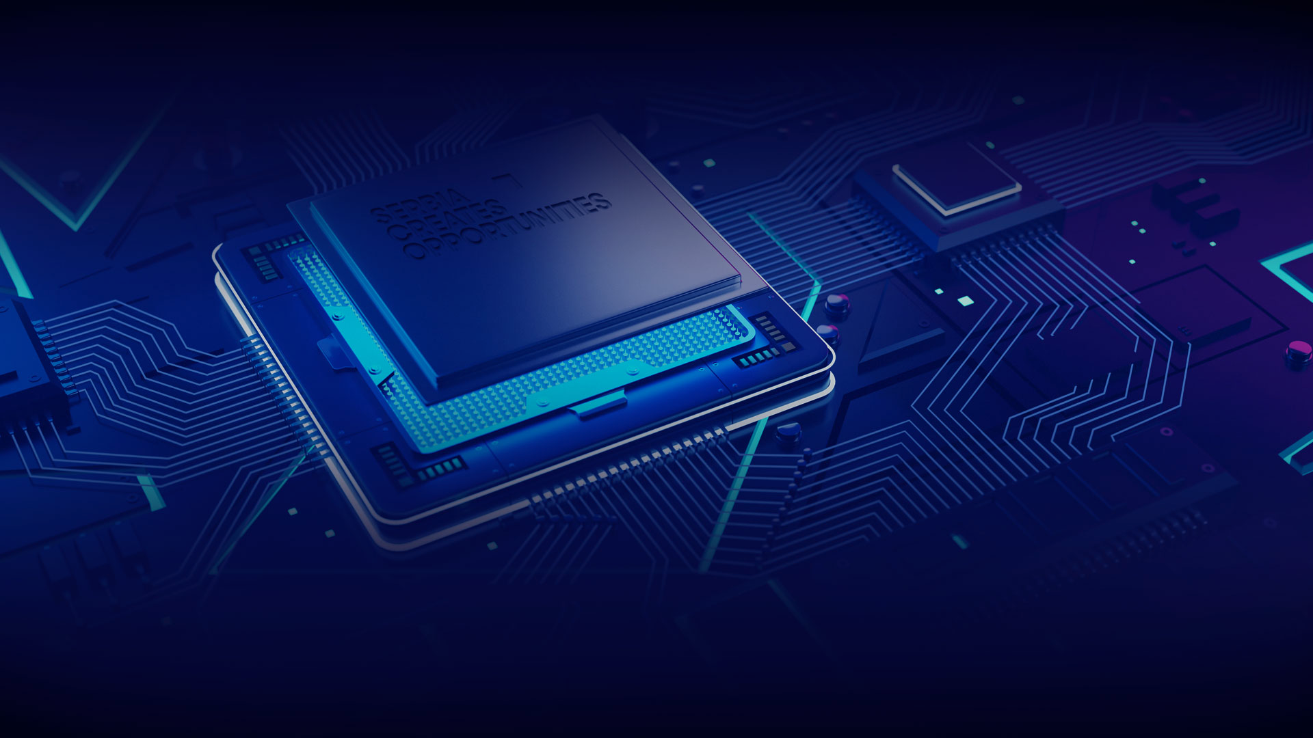
The Government of the Republic of Serbia
Government initiatives focused on AI development
Government as the
AI ecosystem accelerator
Established, highly advanced
public-private collaboration
Infrastructure & subsidies for AI research, development, business operations
Innovation
Fund
Science
Fund
AI Institute
Serbia ranks 46th out of 172 countries in Government AI Readiness Index 2020
53
12
+200
AI projects
ongoing
published research papers
Serbia is the best ranking country in the SEE by the Government AI Readiness Index
Researchers
COPYRIGHT © 2023 THE GOVERNMENT OF THE REPUBLIC OF SERBIA. ALL RIGHTS RESERVED.
Extremely high government commitment to AI since 2019

Slide 27
The Government of the Republic of Serbia
Serbia as an emerging tech hub of Europe
Customs free access to 2.7 B consumers worldwide
Closing the gap
ICT sector general stats
China – Serbia FTA
#1
EU accession in process
First FTA of its kind between China and a nation from CEE.
ICT AS A SERBIAN
NET EXPORTER INDUSTRY
EU + EFTA + UK Trade Agreements
ICT Export
jumped X5
since 2016
No visa regime, simplifying international business travel
Passport
EAEU + Turkey Free Trade Agreement
The only country in Europe to have the Euroasian Economic Union free trade agreement
Customs-free access to 1.3 billion consumers
Approx.
40%
more affordable AVG cost of an ICT (IT) empoloyee
compared to Western Europe
CEFTA Free Trade Agreement
More freedom for local government to offer support
Generalized System of Preferences
Serbian unique trade agreement expand even beyond European and Asian continentail routes
COPYRIGHT © 2023 THE GOVERNMENT OF THE REPUBLIC OF SERBIA. ALL RIGHTS RESERVED.

Slide 28
The Government of the Republic of Serbia
Serbia is enabling regulation
Companies can benefit from two regulatory sandboxes already in place:
New regulatory sandbox
FinTech sandbox
MedTech sandbox
+
Autonomy sandbox
Innovative payment solutions can be tested within a limited market without regular prior registration.
Unregistered medical devices can be imported for R&D on a fast track procedure, if the company is settled in one of Science Technology Parks
Issued a permit for the testing of Autonomous vehicles, autonomy level 3 – there must be a driver at the driver seat of the vehicle.
COPYRIGHT © 2023 THE GOVERNMENT OF THE REPUBLIC OF SERBIA. ALL RIGHTS RESERVED.

Slide 29
The Government of the Republic of Serbia
Employing & Setting up the Business in Serbia is Cost-efficient
Business entity
15
free zones with
Value Added Tax exemptions
for energy consumptions
Corporate Income
Tax credit worth
Tax credit for private individuals investing in VC fund with annual income tax worth
Employee share plans
70% lower tax
for foreigners & Serbian repats
taxed only on capital gains
30%
of the investment in a startup
50% of the investment
at the moment of sale
Deduct ½ of
70% lower tax base for R&D jobs
10 year
Employment
40% less to
Revenue tax is 3%
employ ICT talent in Serbia than in Western Europe
from IP developed in Serbia instead of normal 15%
actual R&D costs, pay less in enterprise revenue tax
salary equal or higher than the national average for 5 years
tax holiday for large investments
COPYRIGHT © 2023 THE GOVERNMENT OF THE REPUBLIC OF SERBIA. ALL RIGHTS RESERVED.

Slide 30
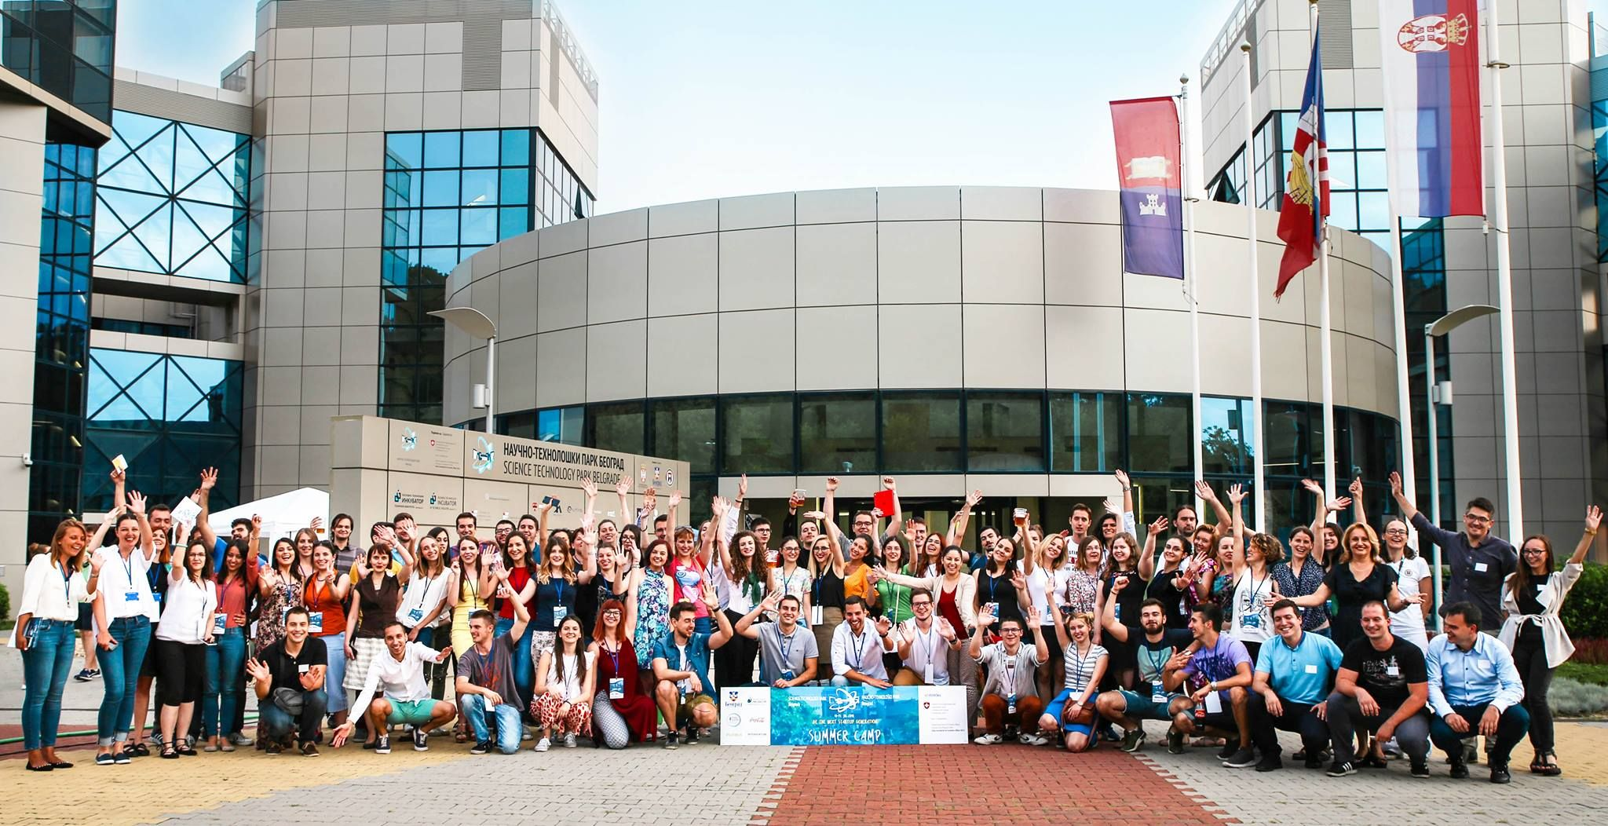
The Government of the Republic of Serbia
Top talent pool for AI development of the future
5 year Savings per positon with 70% lower tax base
Rich supply of home-grown talent
1
Junior Product Manager
25,700€
36% STEM graduates
AI embedded in K-12 education programs, mandatory in 7th & 8th grades
2
Medior Full-Stack Developer
39,200€
500 students expected to enroll by 2025 at AI University programs
3
Senior Team Lead
79,800€
COPYRIGHT © 2023 THE GOVERNMENT OF THE REPUBLIC OF SERBIA. ALL RIGHTS RESERVED.

Slide 31
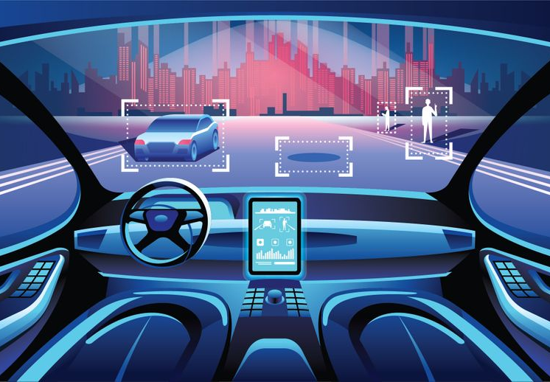
The Government of the Republic of Serbia
Automotive Excellence| 2023
June,2023
Serbia makes crucial steps towards autonomous driving
2023
Serbia issued 2 licenses for testing Level 3 autonomous vehicles
Nov 2023
Serbia passed the legislation for testing of Level 4 Autonomous vehicles
“Serbia becomes one of the first European countries to test autonomous transport solutions, together with the USA and Israel, and stands as a leader in the development of artificial intelligence in the region."
2024
Serbia starts preparing the legislation for testing of Level 5 autonomous vehicles
Ana Brnabić,
Prime Minister of the Republic of Serbia
COPYRIGHT © 2023 THE GOVERNMENT OF THE REPUBLIC OF SERBIA. ALL RIGHTS RESERVED.

Slide 32
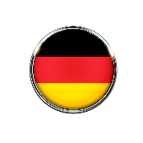
The Government of the Republic of Serbia
Test LEVEL 4 Autonomous vehicles in Serbia in early 2024
Why test Autonomous driving
in Serbia?
Key Automotive industry facts
In 2024, Serbia will be amongst the few who have allowed testing of Level 3 & Level 4 Autonomous vehicles on public roads
#1
70%
Simple & Efficient process of permit approval for
Autonomous testing
FDI sector
in Serbia
Lower tax base
for R&D jobs
Serbia
100 K
2
testing permits given
(more in 2024)
Passport
Employees in
automotive industry
(Jan 2023)
No visa regime, simplifying international business travel
…and
Testing in live traffic in Capital of Serbia - Belgrade
Germany
France
Finland
Level 5
Continuous Development of regulations for Level 5 throughout 2024
Netherlands
Sweden
United Kingdom
Source:ConnectedAutomatedDriving.eu
COPYRIGHT © 2023 THE GOVERNMENT OF THE REPUBLIC OF SERBIA. ALL RIGHTS RESERVED.

Slide 33
The Government of the Republic of Serbia
Let’s talk AI
2024.
Belgrade, Serbia
COPYRIGHT © 2023 THE GOVERNMENT OF THE REPUBLIC OF SERBIA. ALL RIGHTS RESERVED.

Slide 34
The Government of the Republic of Serbia
Incentives overview - 70% lower tax for R&D jobs
IT industry Salary overview
5 year Savings per Position
Level | Position | Net salary starting from (EUR) | Total Costs (Gross 2) (EUR) | Total Costs after incentive (Gross 2) (EUR) | Savings Per Month (EUR) | Savings over 5 years
Junior | Backend Developer | 900€ | 1,448€ | 1,064€ | 384€ | 23,016€
 | Product/Project Manager | 1,000€ | 1,612€ | 1,184€ | 429€ | 25,716€
 | Full-stack developer | 900€ | 1,448€ | 1,064€ | 384€ | 23,016€
 | Frontend developer | 700€ | 1,119€ | 826€ | 294€ | 17,619€
Medior | Backend Developer | 1,500€ | 2,434€ | 1,780€ | 654€ | 39,212€
 | Product/Project Manager | 1,500€ | 2,434€ | 1,780€ | 654€ | 39,212€
 | Full-stack developer | 1,500€ | 2,434€ | 1,780€ | 654€ | 39,212€
 | Frontend developer | 1,500€ | 2,434€ | 1,780€ | 654€ | 39,212€
Senior | Team Lead | 3,000€ | 4,899€ | 3,570€ | 1,329€ | 79,770€
 | Backend Developer | 2,500€ | 4,260€ | 3,028€ | 1,232€ | 73,902€
 | Product/Project Manager | 2,500€ | 4,260€ | 3,028€ | 1,232€ | 73,902€
 | Full-stack developer | 2,500€ | 4,260€ | 3,028€ | 1,232€ | 73,902€
 | Frontend developer | 2,500€ | 4,260€ | 3,028€ | 1,232€ | 73,902€
1
Junior Product Manager
25,700€
2
Medior Full-Stack Developer
39,200€
3
Senior Team Lead
79,800€
COPYRIGHT © 2023 THE GOVERNMENT OF THE REPUBLIC OF SERBIA. ALL RIGHTS RESERVED.

